Slide 1
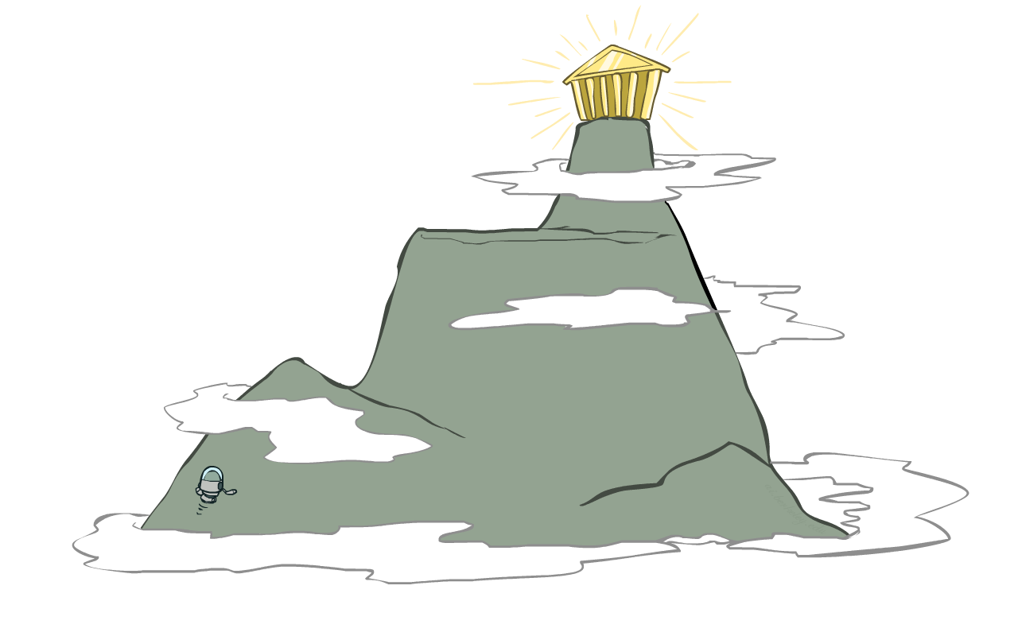



Local Search and Optimization

Slide 2
Local Search Algorithms
The search algorithms we have seen so far keep track of the current state, the “fringe” of the search space, and the path to the final state.
In some problems, one doesn’t care about a solution path but only the orientation of the final goal state
  Example: 8-queen problem
Local search algorithms operate on a single state – current state – and move to one of its neighboring states
  Solution path needs not be maintained
  Hence, the search is “local”

Slide 3
Local Search Algorithms
When there is no need to memorize the path to the goal, just to find the goal.
Cost of the path and finding optimal path to the goal is not required.
Start from a single current state and check the neighboring states
Consumes little memory
Useful with large state space.

Slide 4
Local Search
Tree search keeps unexplored alternatives on the fringe (ensures completeness)
Local search: improve a single option until you can’t make it better (no fringe!)
New successor function: local changes
Generally much faster and more memory efficient (but incomplete and suboptimal)

Slide 5
Local Search Methods – Applications
Applicable when seeking Goal State & don't care how to get there. E.g.,
  N-queens,
  finding shortest/cheapest round trips
    (Travel Salesman Problem, Vehicle Routing Problem)
  finding models of propositional formulae (SAT solvers)
  map coloring,
  resource allocation
  protein structure prediction
  genome sequence assembly

Slide 6
Local Search Algorithms
In many optimization problems, the path to the goal is irrelevant; the goal state itself is the solution
State space = set of configurations
  Find a configuration satisfying your constraints, e.g., n-queens
  Find the best possible state according to a given objective function
In such cases, we can use local search algorithms
  Keeps a single "current" state, and then shift states, but don’t keep track of paths.
  Use very limited memory
  Find reasonable solutions in large state spaces.

Slide 7
Local Search Algorithm
Local search algorithms work as follows:
  Pick a “solution” from the search space and evaluate it. Define this as the current solution.
  Apply a transformation to the current solution to generate and evaluate a new solution.
  If the new solution is better than the current solution then exchange it with the current solution; otherwise discard the new solution.
  Repeat steps 2 and 3 until no transformation in the given set improves the current solution

Slide 8
Local search
Key idea (surprisingly simple):
  Select (random) initial state (generate an initial guess)
  Make local modification to improve current state
    Evaluate current state and move to other states
  Repeat Step 2 until goal state found (or out of time)
Neighborhoods

Slide 9
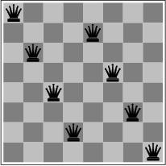
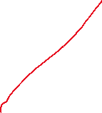
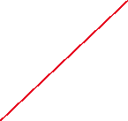
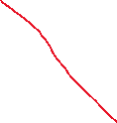


Local Search Algorithms for optimization Problems
Local search algorithms are very useful for optimization problems
systematic search doesn’t work
however, can start with a suboptimal solution and improve it
Goal: find a state such that the objective function is optimized
Minimize the number
of attacks

Slide 10
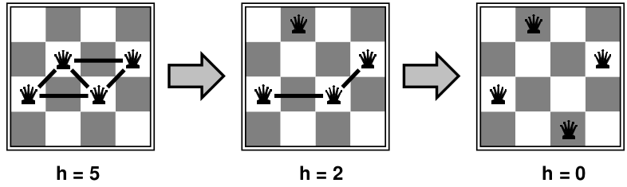



Example: n-Queen
Put N Queens on an n × n board with no two queens on the same row, column, or diagonal
Move a queen to reduce number of conflicts
Almost always solves n-queens problems instantaneously for very large n, e.g., n = 1 million
Initial state … Improve it … using local transformations

Slide 11
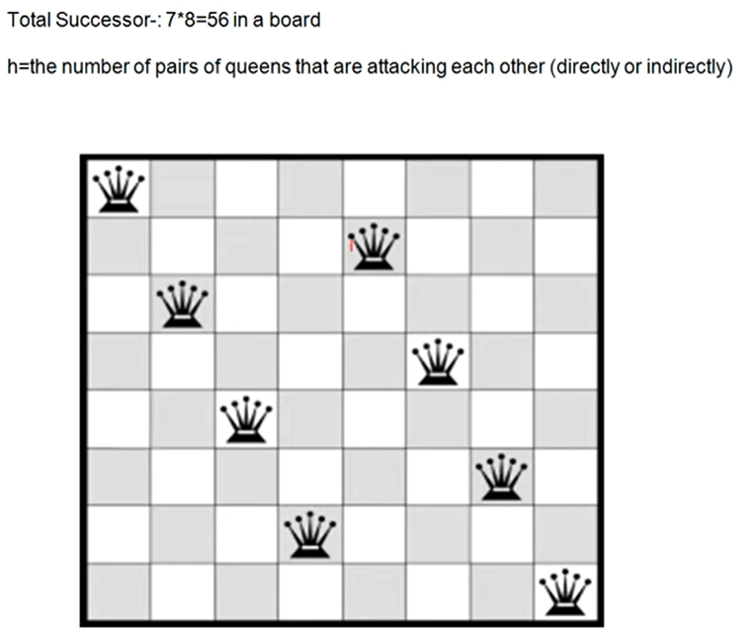

Slide 12
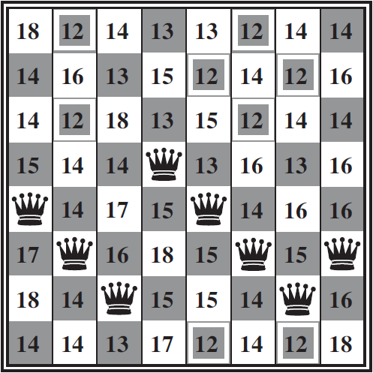
Example: n-Queen
Put N Queens on an n × n board with no two queens on the same row, column, or diagonal

Slide 13
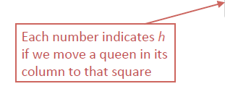
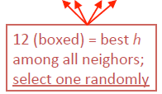
Example: n-Queen
Put N Queens on an n × n board with no two queens on the same row, column, or diagonal
HEURISTIC:
h = # of pairs of queens that are attacking each other, either directly or indirectly

Slide 14
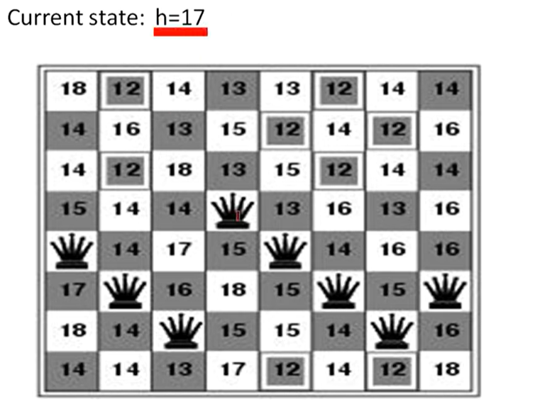

Slide 15
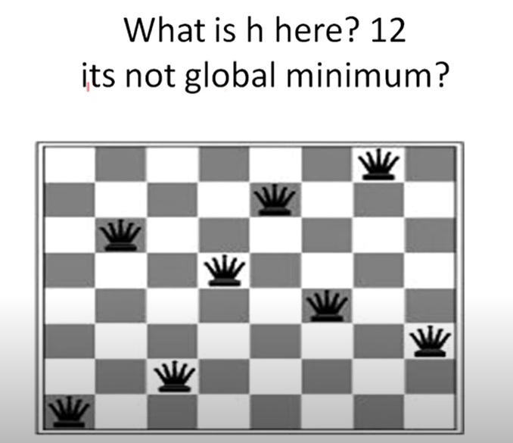

Slide 16

Hill Climbing
Algorithm
Gradient Ascent/Descent Algorithm

Slide 17



Hill Climbing
Simple, general idea:
  Start wherever
  Repeat: move to the best neighboring state
  If no neighbors better than current, quit
What’s bad about this approach?
  Complete?
  Optimal?
Hill climbing algorithm (a.k.a. greedy local search) uses a loop that continually moves in the direction of increasing values (that is uphill).
It terminates when it reaches a peak where no neighbor has a higher value.
"Like climbing Everest in thick fog with amnesia"

Slide 18

Hill-Climbing Algorithm
Pick a random point in the search space
Consider all the neighbors of the current state
Choose the neighbor with the best quality and move to that state
Repeat 2 to 4 until all the neighboring states are of lower quality
Return the current state as the solution state.

Slide 19
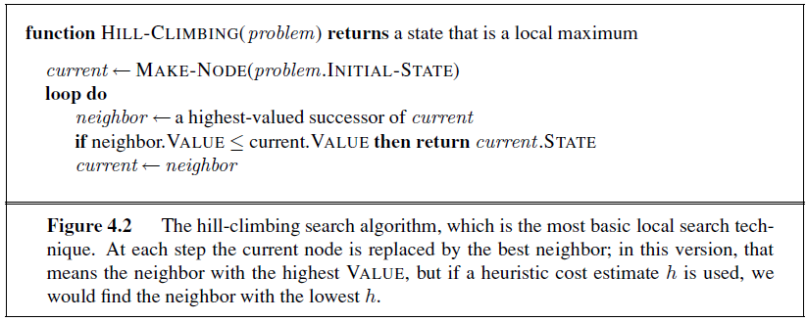
Hill Climbing Search
Steepest Ascent Search, Greedy Local Search
Iteratively maximize value of current state by replacing its successors state that has highest value , as long as possible.

Slide 20
Hill Climbing Search
Hill-climbing strategies expand the current state of the search and evaluate its children.
The “best” child is selected for further expansion; neither its siblings nor its parent are retained.
Because it keeps no history, the algorithm cannot recover from failures of its strategy.
The algorithm does not maintain a search tree, so the data structure for the current node need only record the state and the value of the objective function.

Slide 21
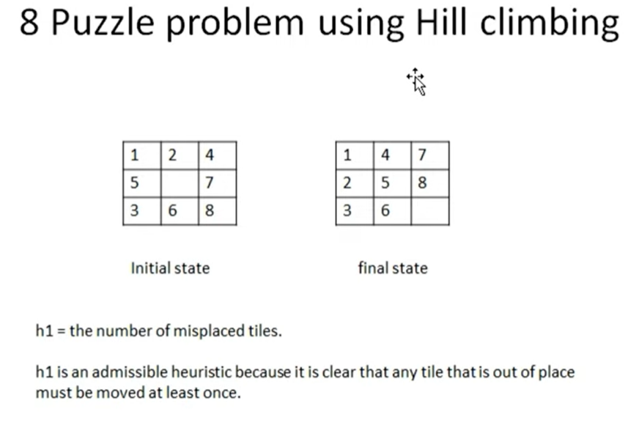

Slide 22
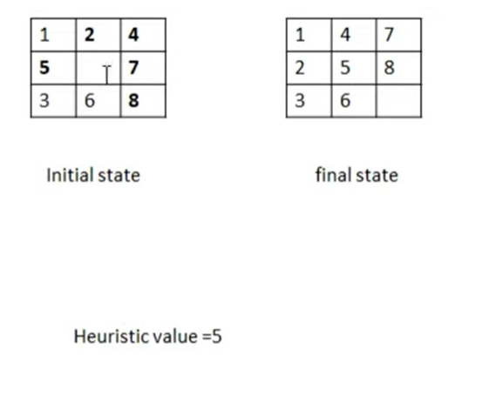

Slide 23
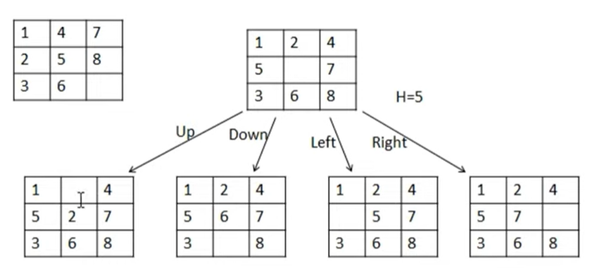


Slide 24
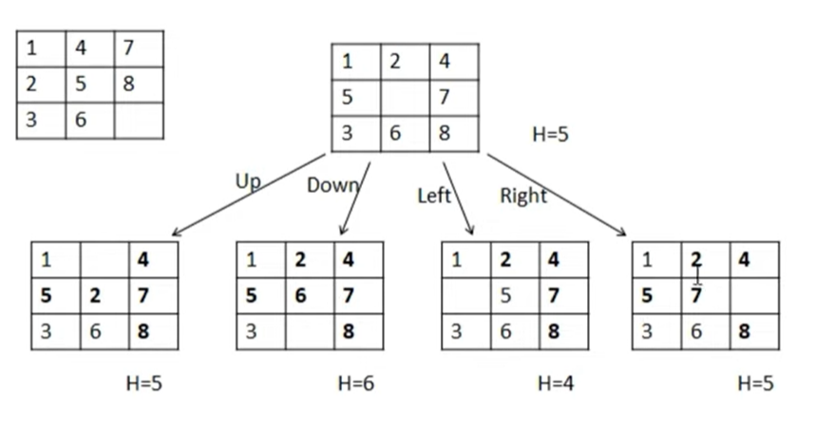

Slide 25
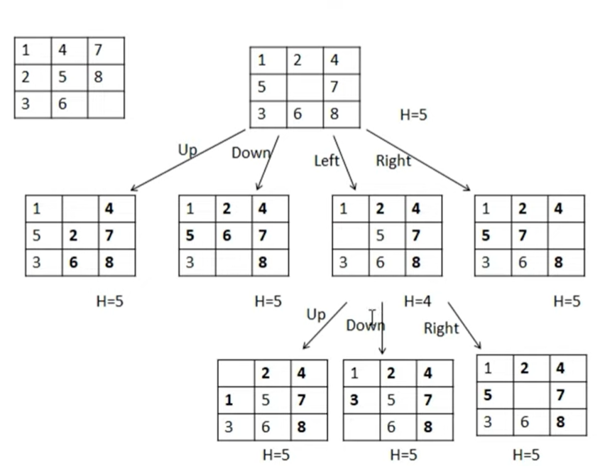
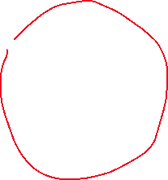
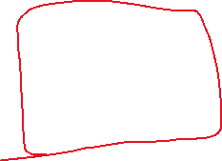

Local maxima
Problem

Slide 26
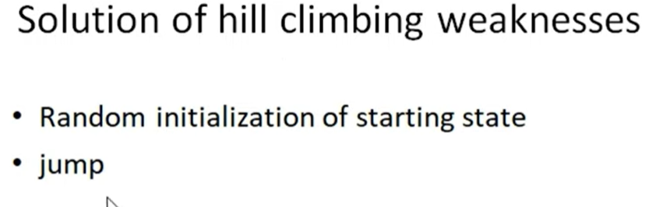

Slide 27
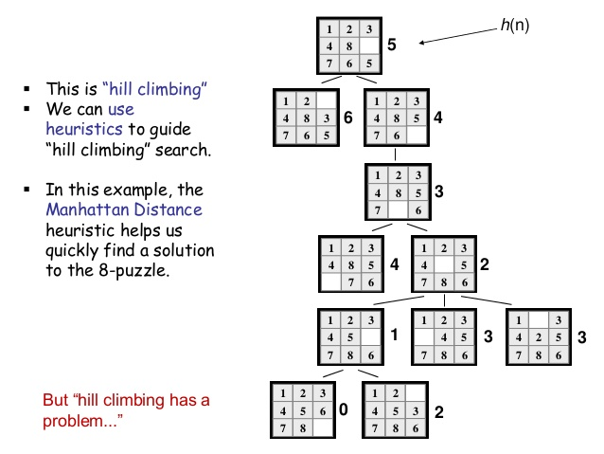

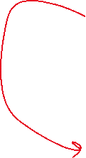



Slide 28
Hill climbing example (minimizing h)
3
1
2
1
2
start
4
5
8
h_{oop} = 5
goal
3
4
5
6
7
6
7
8
h_{oop} = 4
h_{oop} = 0
6
5
3
1
2
3
1
2
4
5
8
4
5
6
7
6
7
8
h_{oop} = 3
h_{oop} = 1
5
4
3
1
2
3
1
2
4
5
h_{oop} = 2
4
5
6
7
8
6
7
8
4

Slide 29
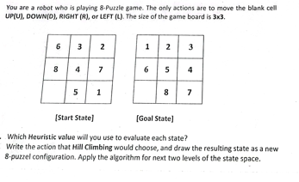
Activity

Slide 30
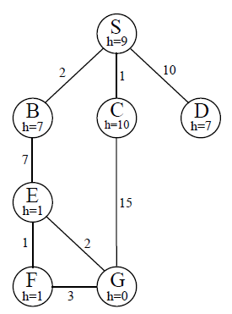

Slide 31
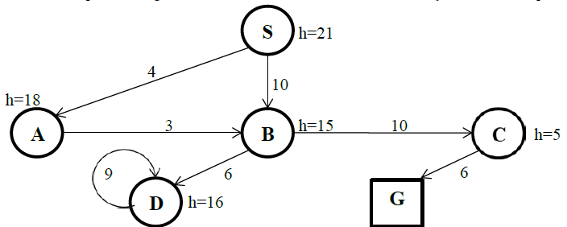
Activity

Slide 32
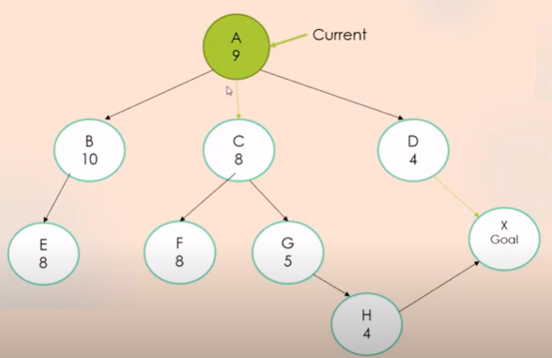

Slide 33
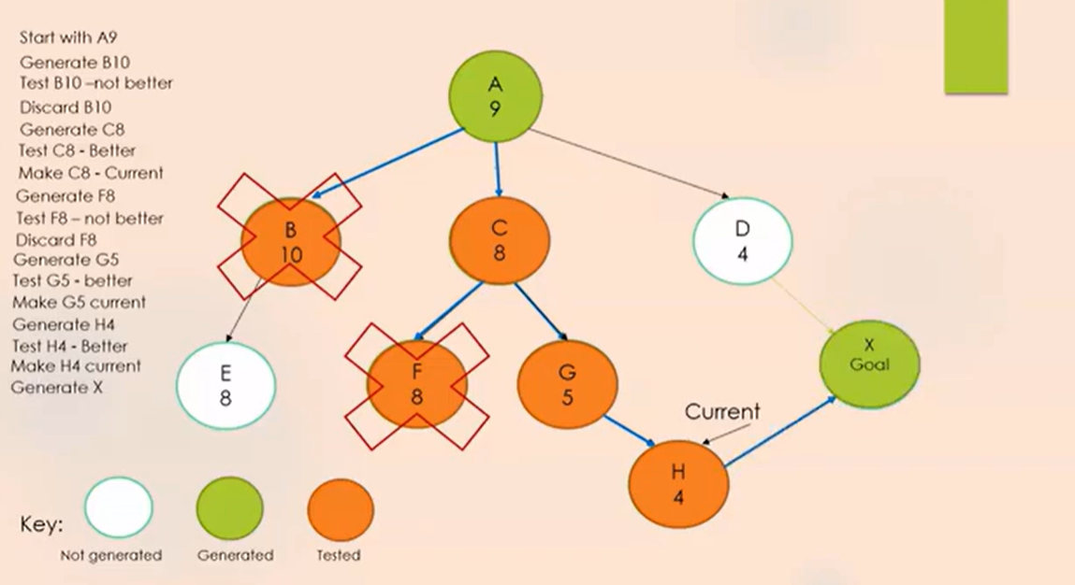

Slide 34
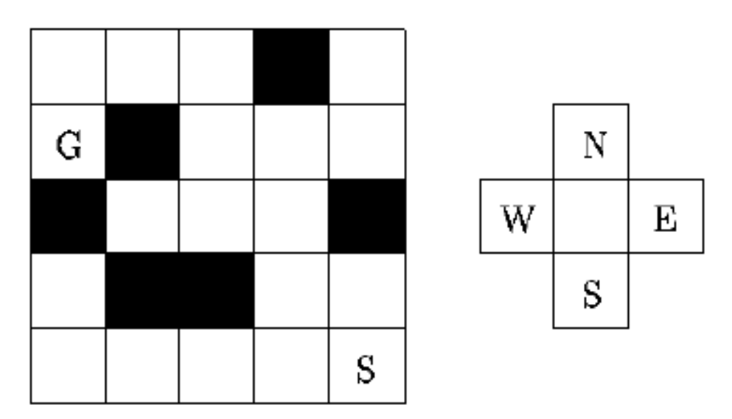
Example of hill-climbing for the maze problem
Consider the following maze:
The problem is to get from the start node S to the goal node G, by moving horizontally and vertically and avoiding the black obstacles in the above maze.

Slide 35
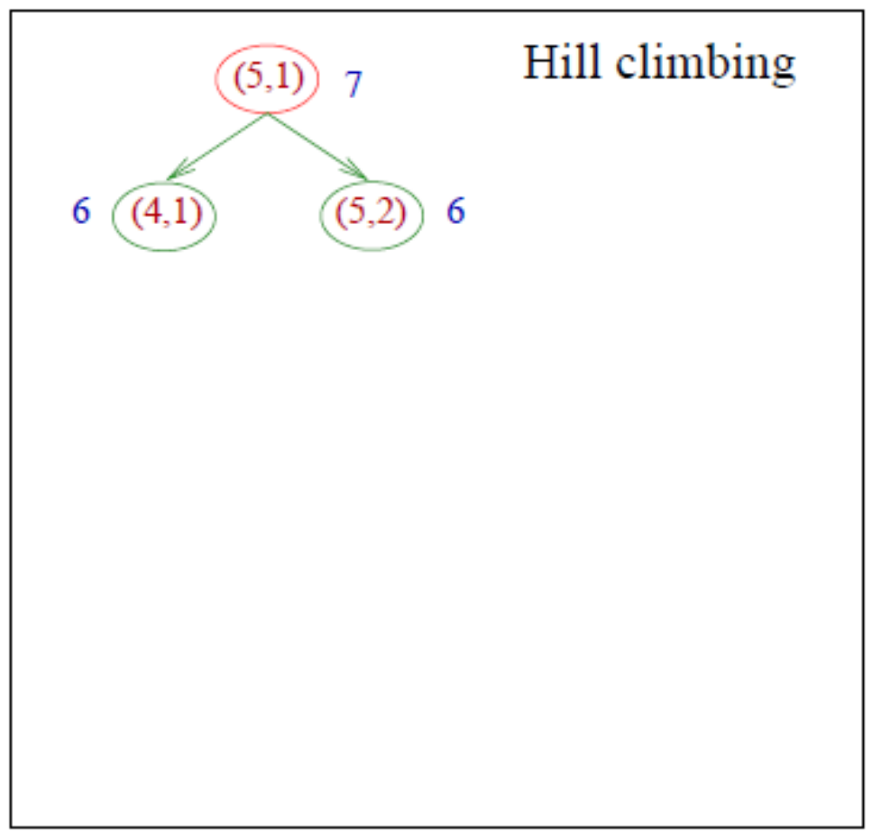
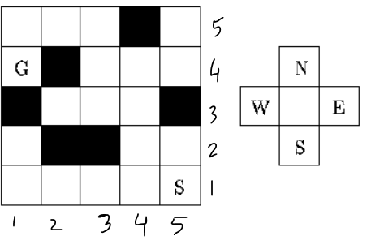
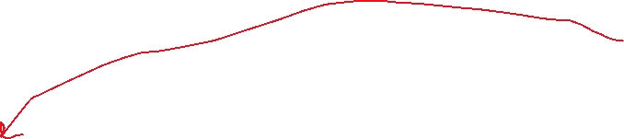

In the figures describing the steps of the algorithm
each position will be denoted by a pair of numbers which are the horizontal and vertical coordinates (that is, for (x, y), x denotes the horizontal coordinate and y denotes the vertical coordinate).
The Manhattan distance between the points (x, y) and (z, t) is given by d((x, y), (z, t)) = |x − z| + |y − t|.

Slide 36
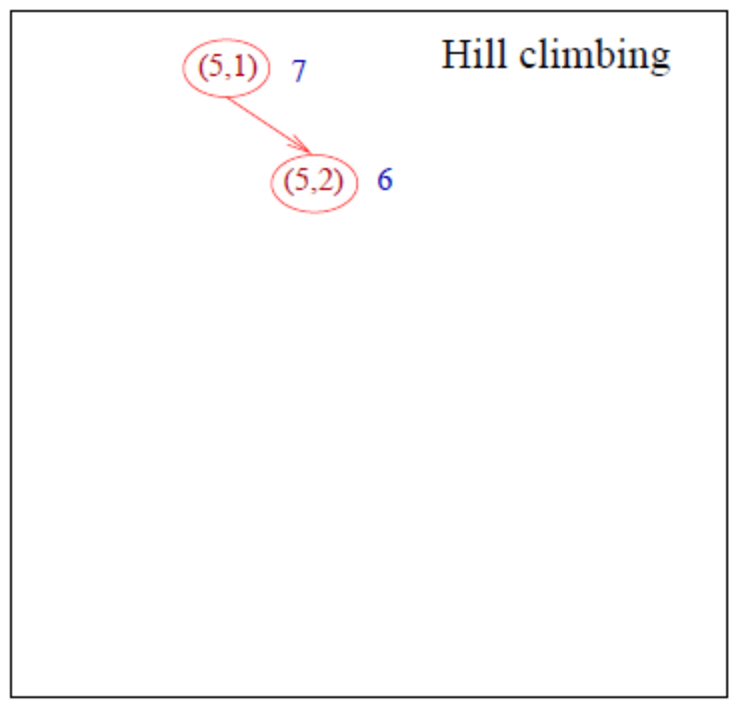
In the figures describing the steps of the algorithm
each position will be denoted by a pair of numbers which are the horizontal and vertical coordinates (that is, for (x, y), x denotes the horizontal coordinate and y denotes the vertical coordinate).
If there is tie between N and another direction then priorities N
The Manhattan distance between the points (x, y) and (z, t) is given by d((x, y), (z, t)) = |x − z| + |y − t|.

Slide 37
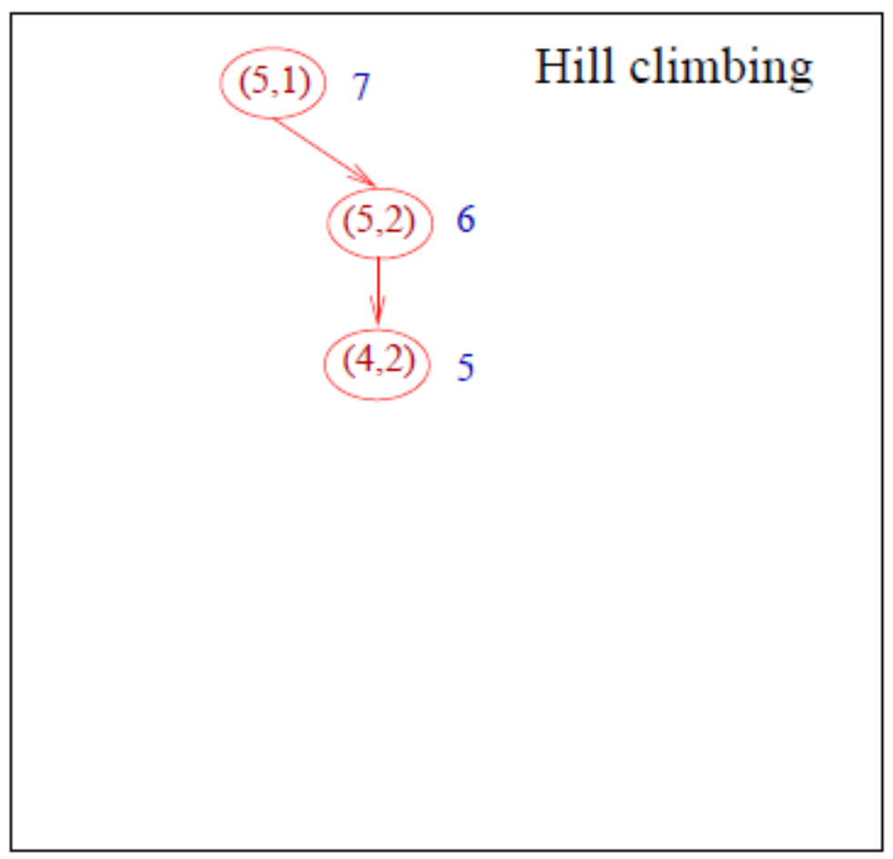
In the figures describing the steps of the algorithm
each position will be denoted by a pair of numbers which are the horizontal and vertical coordinates (that is, for (x, y), x denotes the horizontal coordinate and y denotes the vertical coordinate).
The Manhattan distance between the points (x, y) and (z, t) is given by d((x, y), (z, t)) = |x − z| + |y − t|.
When there is a tie between N and W priorities N

Slide 38
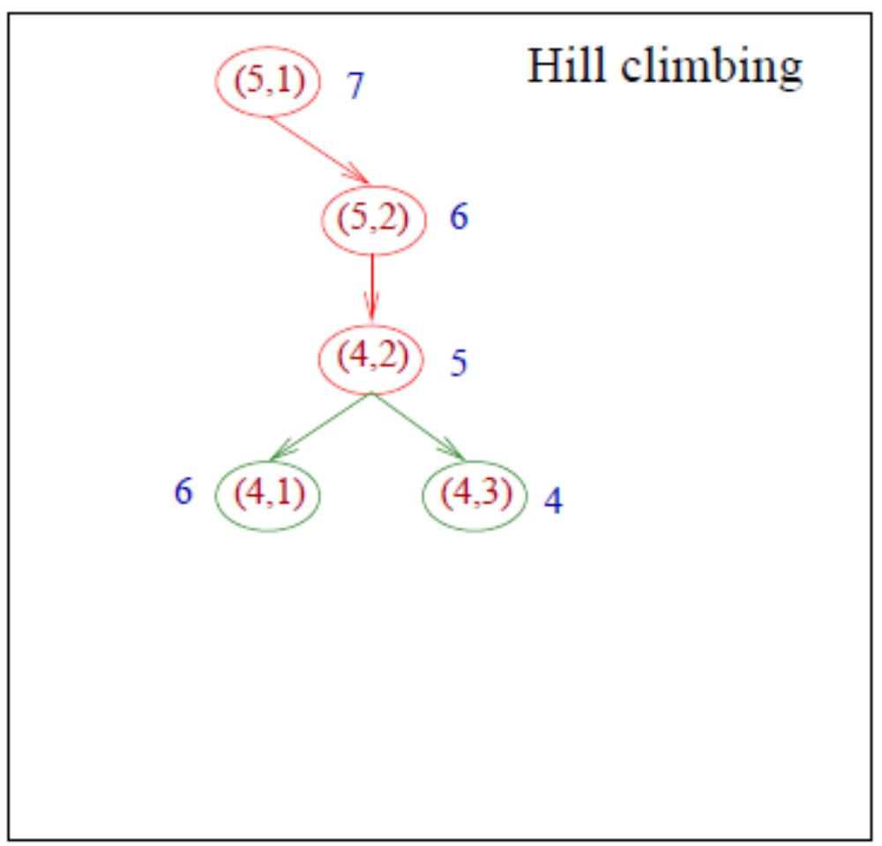
In the figures describing the steps of the algorithm
each position will be denoted by a pair of numbers which are the horizontal and vertical coordinates (that is, for (x, y), x denotes the horizontal coordinate and y denotes the vertical coordinate).
The Manhattan distance between the points (x, y) and (z, t) is given by d((x, y), (z, t)) = |x − z| + |y − t|.

Slide 39
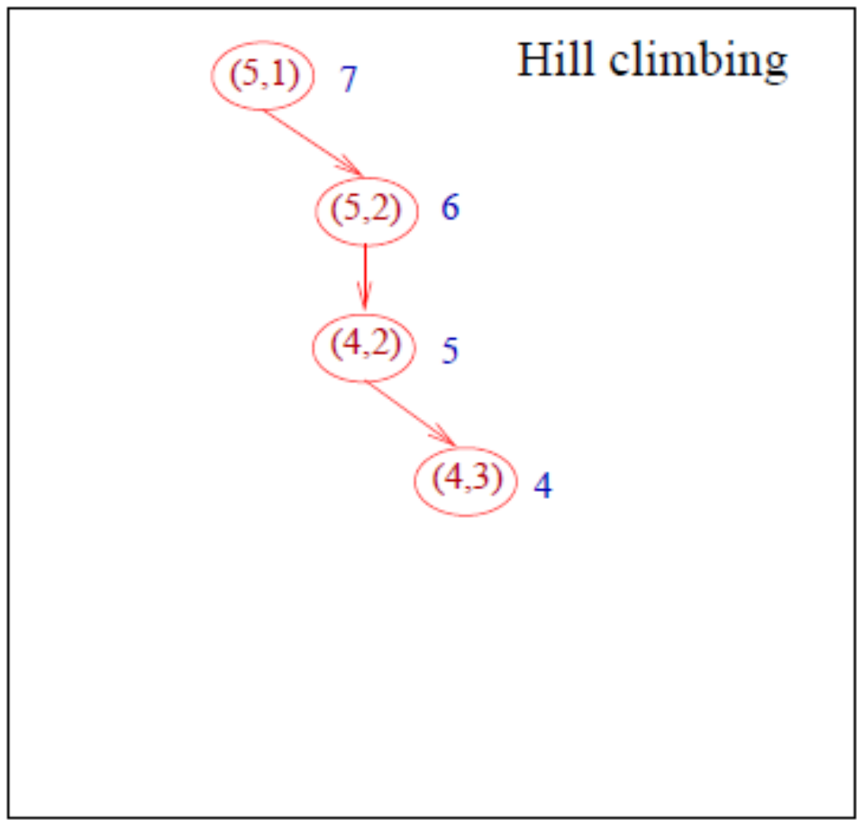
In the figures describing the steps of the algorithm
each position will be denoted by a pair of numbers which are the horizontal and vertical coordinates (that is, for (x, y), x denotes the horizontal coordinate and y denotes the vertical coordinate).
The Manhattan distance between the points (x, y) and (z, t) is given by d((x, y), (z, t)) = |x − z| + |y − t|.

Slide 40
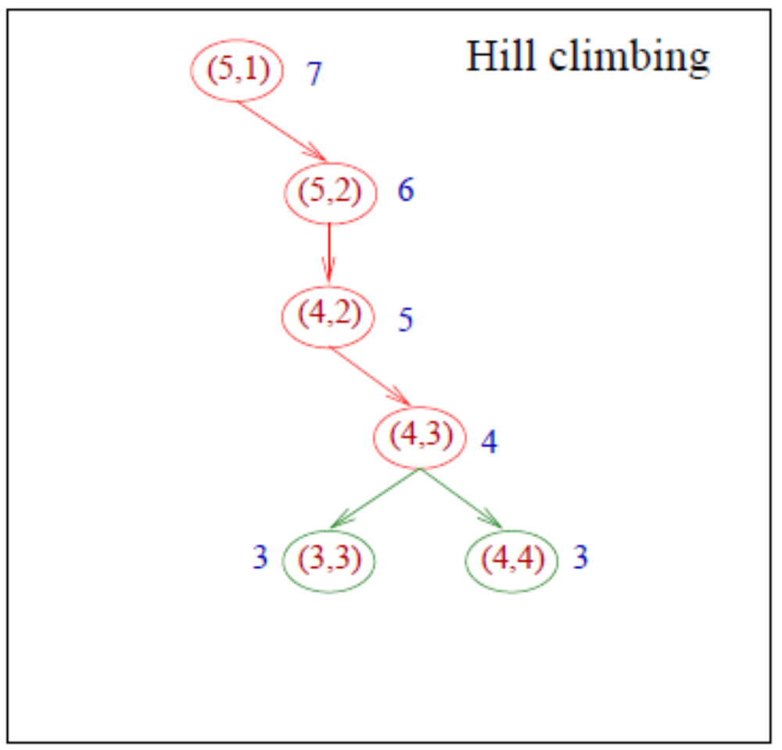
In the figures describing the steps of the algorithm
each position will be denoted by a pair of numbers which are the horizontal and vertical coordinates (that is, for (x, y), x denotes the horizontal coordinate and y denotes the vertical coordinate).
The Manhattan distance between the points (x, y) and (z, t) is given by d((x, y), (z, t)) = |x − z| + |y − t|.

Slide 41
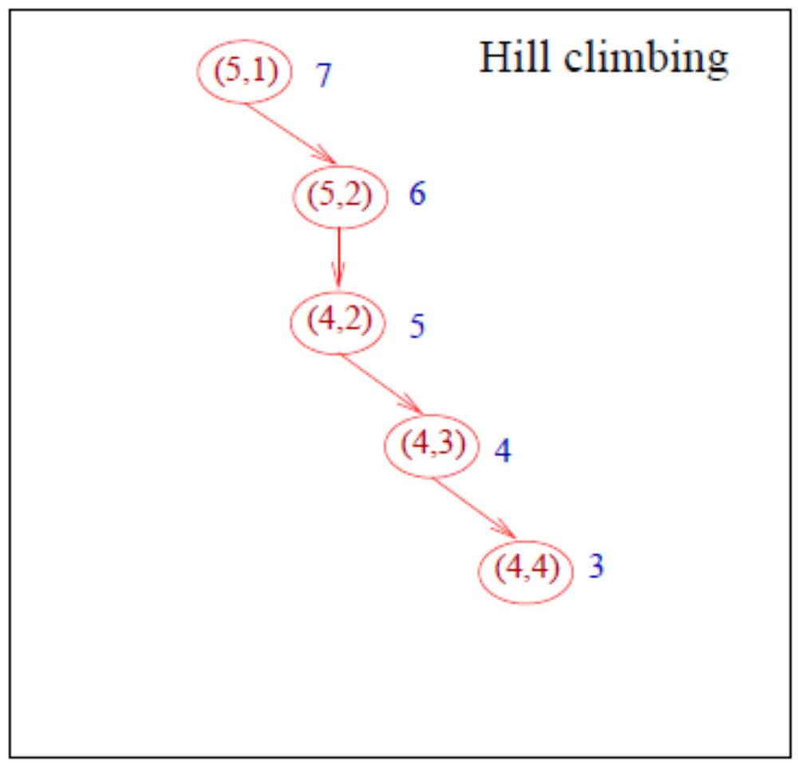
In the figures describing the steps of the algorithm
each position will be denoted by a pair of numbers which are the horizontal and vertical coordinates (that is, for (x, y), x denotes the horizontal coordinate and y denotes the vertical coordinate).
The Manhattan distance between the points (x, y) and (z, t) is given by d((x, y), (z, t)) = |x − z| + |y − t|.

Slide 42
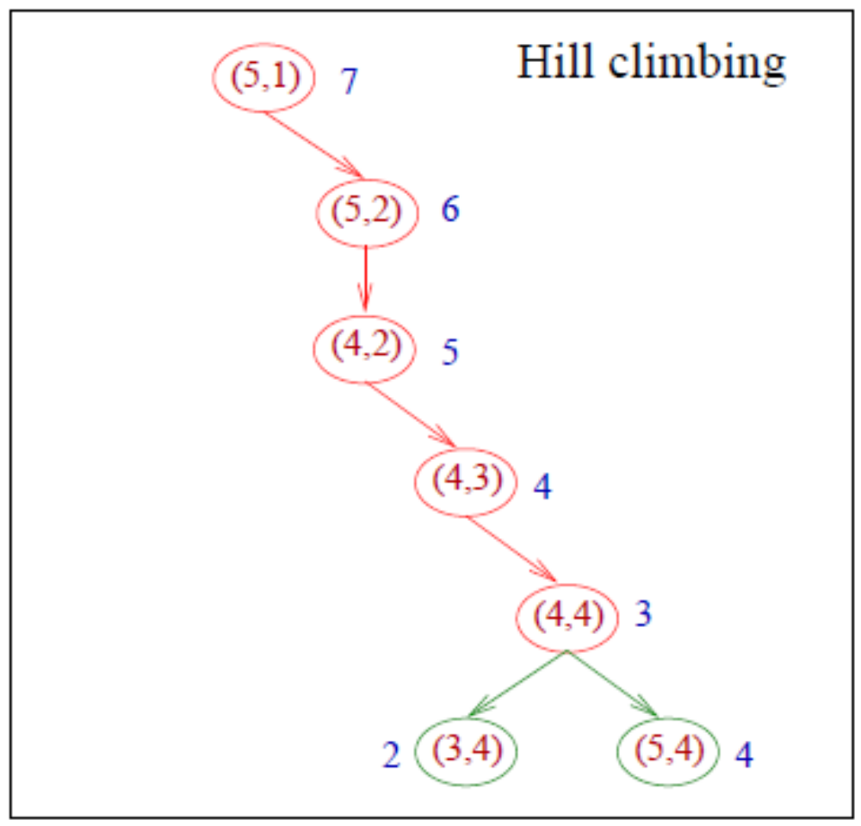
In the figures describing the steps of the algorithm
each position will be denoted by a pair of numbers which are the horizontal and vertical coordinates (that is, for (x, y), x denotes the horizontal coordinate and y denotes the vertical coordinate).
The Manhattan distance between the points (x, y) and (z, t) is given by d((x, y), (z, t)) = |x − z| + |y − t|.

Slide 43
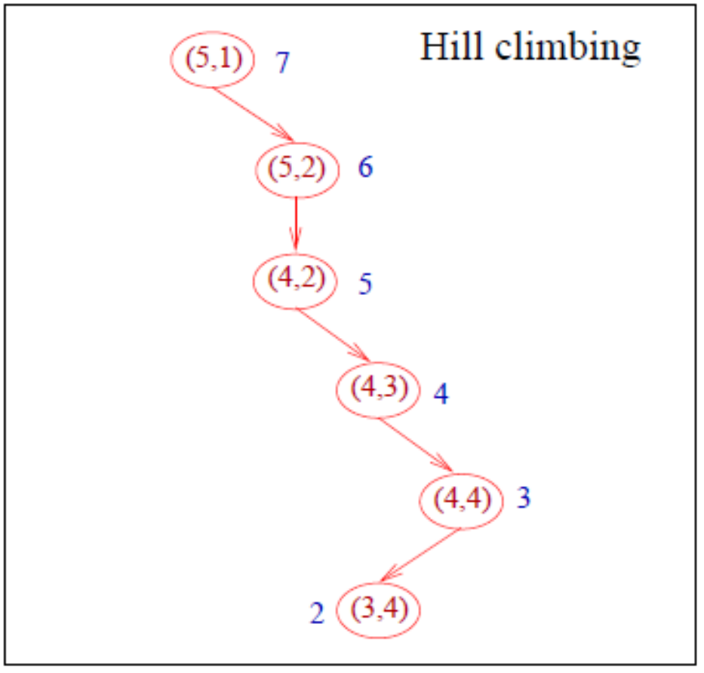
Example of hill-climbing for the maze problem
The algorithm is stuck in (3,4) because all neigbours of (3,4) are worse than (3,4) (i.e., they have a higher Manhattan distance).

Slide 44
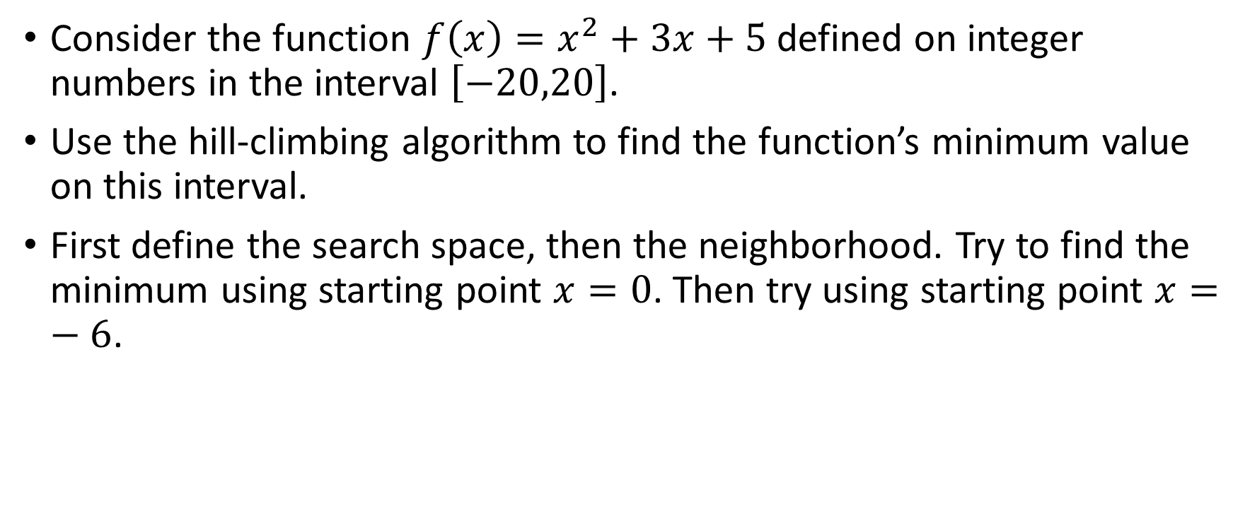
Example of hill-climbing for finding the minimum of a quadratic function
Consider the function $f\left(x\right)=x^{2}+3x+5$ defined on integer numbers in the interval $\left[−20,20\right]$.
Use the hill-climbing algorithm to find the function’s minimum value on this interval.
First define the search space, then the neighborhood. Try to find the minimum using starting point $x=0$. Then try using starting point $x=−6$.

Slide 45
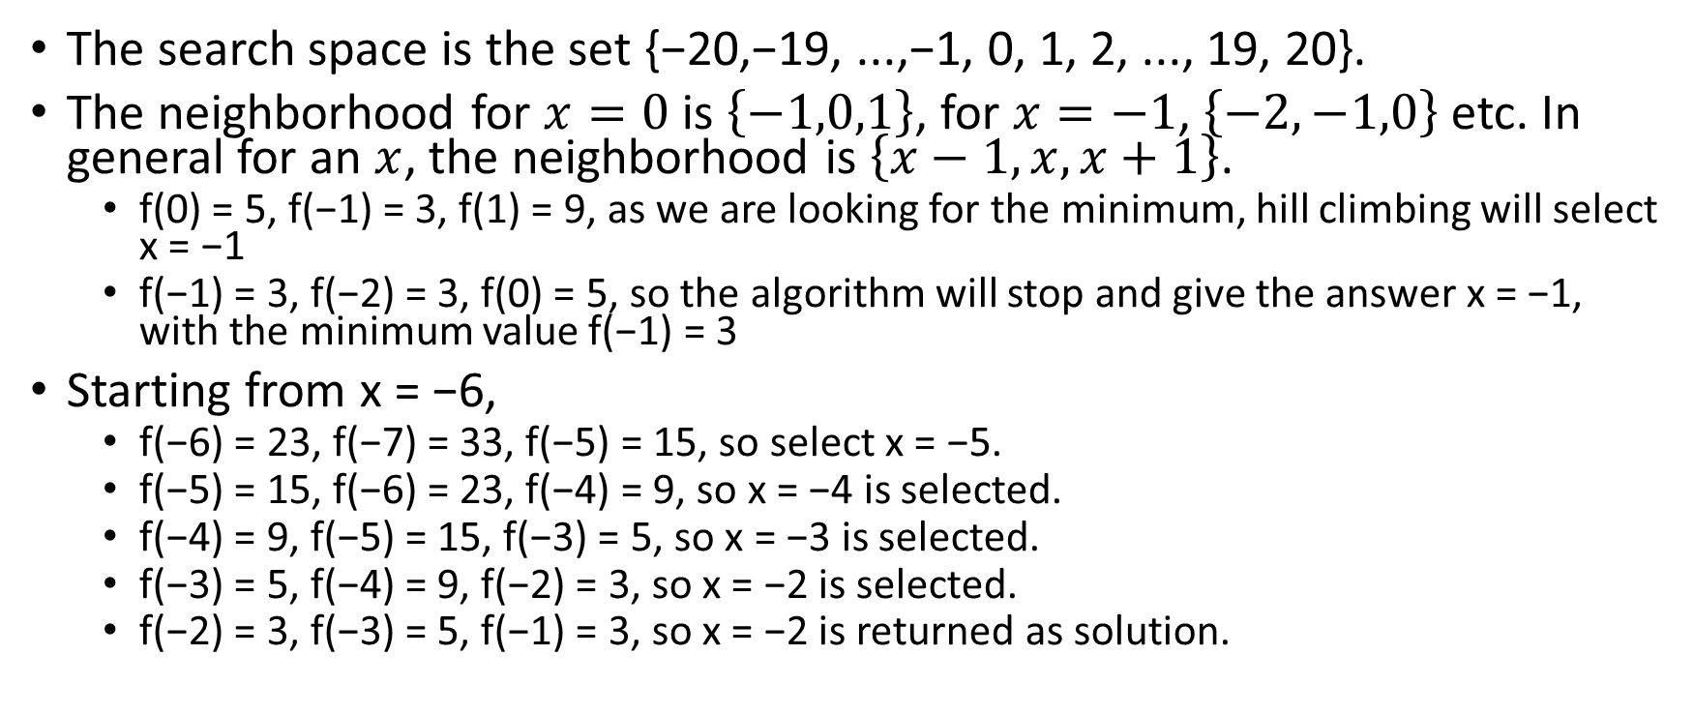
Example of hill-climbing for finding the minimum of a quadratic function
The search space is the set {−20,−19, ...,−1, 0, 1, 2, ..., 19, 20}.
The neighborhood for $x=0$ is $\left\{−1,0,1\right\}$, for $x=−1$, $\left\{−2,−1,0\right\}$ etc. In general for an $x$, the neighborhood is $\left\{x−1,x,x+1\right\}$.
  f(0) = 5, f(−1) = 3, f(1) = 9, as we are looking for the minimum, hill climbing will select x = −1
  f(−1) = 3, f(−2) = 3, f(0) = 5, so the algorithm will stop and give the answer x = −1, with the minimum value f(−1) = 3
Starting from x = −6,
  f(−6) = 23, f(−7) = 33, f(−5) = 15, so select x = −5.
  f(−5) = 15, f(−6) = 23, f(−4) = 9, so x = −4 is selected.
  f(−4) = 9, f(−5) = 15, f(−3) = 5, so x = −3 is selected.
  f(−3) = 5, f(−4) = 9, f(−2) = 3, so x = −2 is selected.
  f(−2) = 3, f(−3) = 5, f(−1) = 3, so x = −2 is returned as solution.

Slide 46
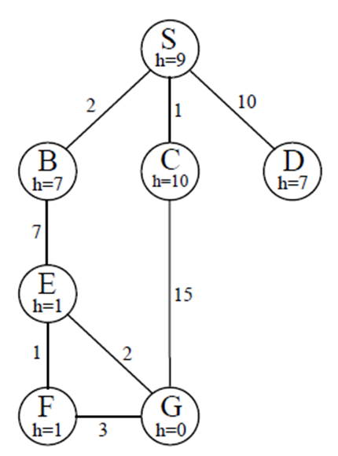
 | Frontier (Hill Climbing( | Expand | Explored
1 | (S,9) | S
2 | (S-B,7)(S-C,10)(S-D,7) | B
3 | (S-B-E,1) | E
4 | (S-B-E-F,1) (S-B-E-G,0) | G
5 | (S-B-E-G,0)
No frontier required in Local search

Slide 47
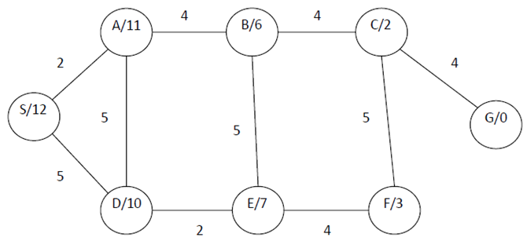
 | Frontier (Hill Climbing( | Expand | Explored

Slide 48
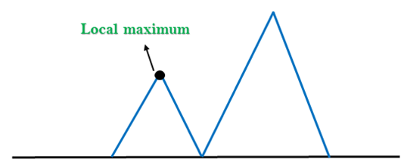
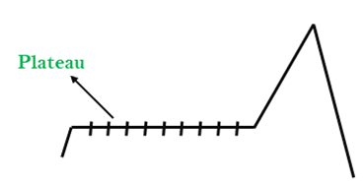
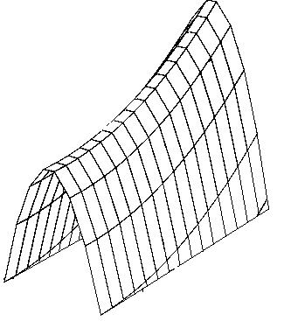






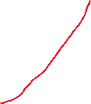
Problems with Hill Climbing in AI
Local Maximum
A local maximum is a peak state in the landscape which is better than each of its neighboring states, but there is another state also present which is higher than the local maximum.
Plateau
A plateau is the flat area of the search space in which all the neighbor states of the current state contains the same value, because of this algorithm does not find any best direction to move. A hill-climbing search might be lost in the plateau area.
Ridge
A ridge is a special form of the local maximum. It has an area which is higher than its surrounding areas, but itself has a slope, and cannot be reached in a single move.
Ridge

Slide 49
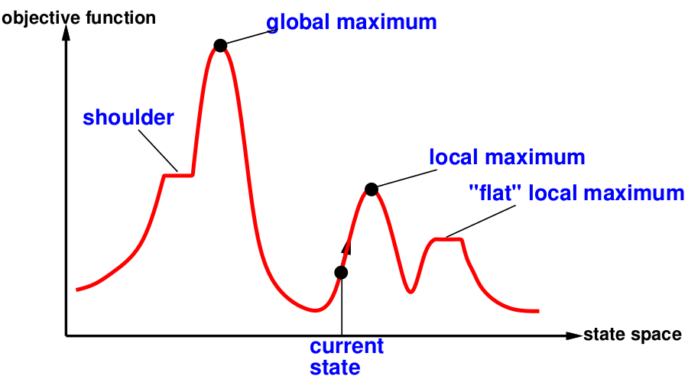
State Space Landscape
A state space landscape is a graph of states associated with their costs
A landscape has both “location” (defined by the state) and “elevation” (defined by the value of the heuristic cost function or objective function).

Slide 50
Hill Climbing
evaluation
states

Slide 51
Hill-Climbing – Two Versions
Greedy Local Search
  Systematically search the Neighbourhood.
  Accept the {first or best} cost decreasing move found.
Stochastic Local Search
  Choose randomly from amongst the cost-decreasing moves found.

Slide 52
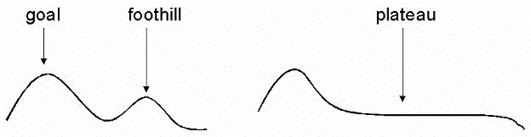
Hill-Climbing Problems
Greedy Local Search: grabs a good neighbour state without thinking about where to go next
  However, greedy algos do make good progress generally towards the solution
Unfortunately, hill-climbing
  Can get stuck in local maxima
  Can be stuck by ridges (a series of local maxima that occur close together)
  Can be stuck by plateau (a flat area in the state space landscape)
    Shoulder: if the flat area rises uphill later on
    Flat local maximum: no uphill rise exists.

Slide 53
Example of a local "maximum"
4
2
2
3
1
5
start
6
7
8
goal
4
1
2
4
1
2
1
2
3
5
3
7
5
2
3
4
5
0
6
7
8
6
8
6
7
8
1
4
1
2
3
5
2
6
7
8

Slide 54


Hill-Climbing Problems
Local maxima/minima : local search can get stuck on a local maximum/minimum and not find the optimal solution
Cure
  + Random restart
  + Good for Only few local maxima
Local minimum

Slide 55
Improvements
Random-restart Hill Climbing: Selects a series of initial nodes randomly until the solution is found.
Some problem spaces are great for hill climbing and others are terrible.

Slide 56
Complexity
Time Complexity = O(b × d)
or in the more general case, O(N)
From each current state, we generate and evaluate up to b neighbors.
This process continues until:
  A maximum/minimum is found (stopping criterion)
  Or all states are visited (worst case)
So, the total time is proportional to the number of generated neighbors.
Space Complexity = O(1) or O(b)

Slide 57
Variants of Hill Climbing
Stochastic hill climbing:
  chooses at random from among uphill moves
  converges more slowly, but finds better solutions in some landscapes.
First-choice hill climbing:
  generate successors randomly until one is better than the current
  good when a state has many successors
Random-restart hill climbing:
  conducts a series of hill climbing searches from randomly generated initial states, stops when a goal is found
  It’s complete with probability approaching 1

Slide 58
Variants
In simple hill climbing, the first closer node is chosen, whereas in steepest ascent hill climbing all successors are compared and the closest to the solution is chosen. Steepest ascent hill climbing is similar to best-first search, which tries all possible extensions of the current path instead of only one.
Stochastic hill climbing does not examine all neighbors before deciding how to move. Rather, it selects a neighbor at random, and decides (based on the amount of improvement in that neighbor) whether to move to that neighbor or to examine another.
Random-restart hill climbing iteratively does hill-climbing, each time with a random initial condition. The best is kept: if a new run of hill climbing produces a better than the stored state, it replaces the stored state.

Slide 59
Stochastic Hill Climbing
Stochastic hill climbing chooses at random from among the uphill moves;
The probability of selection can vary with the steepness of the uphill move.
Stochastic hill climbing usually converges more slowly than steepest ascent, but in some state landscapes, it finds better solutions.
Stochastic hill climbing is NOT complete, but it may be less likely to get stuck

Slide 60
First Choice Hill Climbing
First-choice hill climbing implements stochastic hill climbing by generating successors randomly until one is generated that is better than the current state.
This is a good strategy when a state has many of successors.
First-choice hill climbing is also NOT complete,

Slide 61
Random Restart Hill Climbing
Random-Restart Hill Climbing conducts a series of hill-climbing searches from randomly generated initial states, until a goal is found.
Random-Restart Hill Climbing is complete if infinite (or sufficiently many tries) are allowed.
If each hill-climbing search has a probability p of success, then the expected number of restarts required is 1/p.
The success of hill climbing depends very much on the shape of the state-space landscape:
If there are few local maxima and plateau, random-restart hill climbing will find a good solution very quickly.
On the other hand, many real problems have many local maxima to get stuck on.

Slide 62
Nature-Inspired Heuristic Algorithms
Genetic Algorithm (evolution)
Neural Network (artificial neural network)
Simulated Annealing (metal annealing)
Tabu Search (animal’s brain)
Ant Colony Optimization
Bee Colony Optimization

